Slide 1


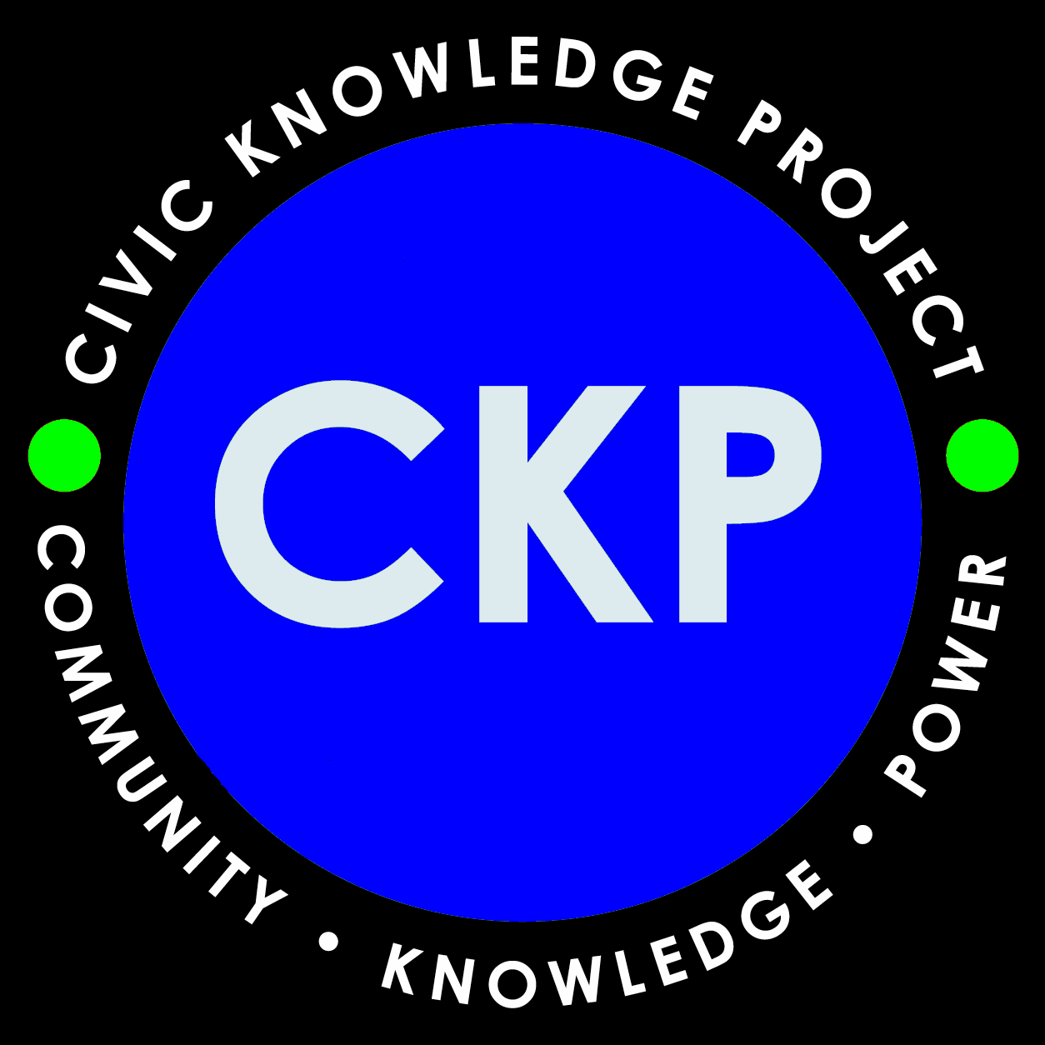
Introducing
The UChicago Civic Knowledge Project’s

Slide 2

Winning Words from the South Side
A course in critical thinking, philosophy, civic knowledge, and democratic practice grounded in …

Slide 3
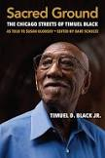

The Sacred Ground of Chicago’s legendary educator and activist Timuel D. Black!

Slide 4
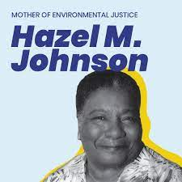
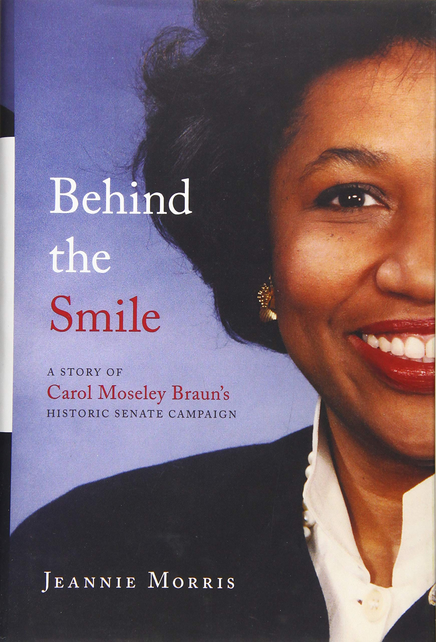
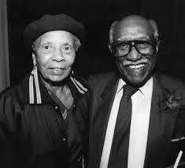
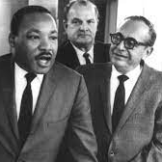
And friends …

Slide 5
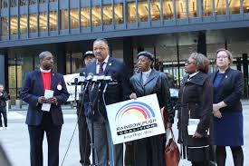
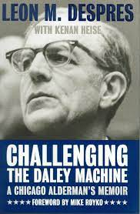
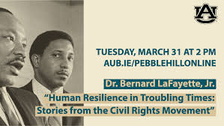
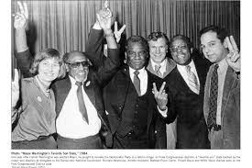
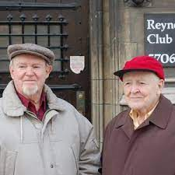
And more friends …

Slide 6
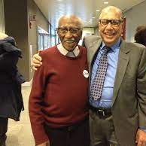
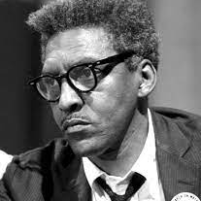
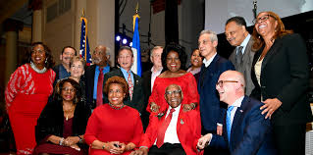
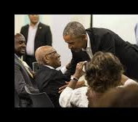
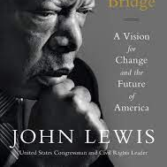
The circle of friends could keep on expanding …
But you get the idea!

Slide 7
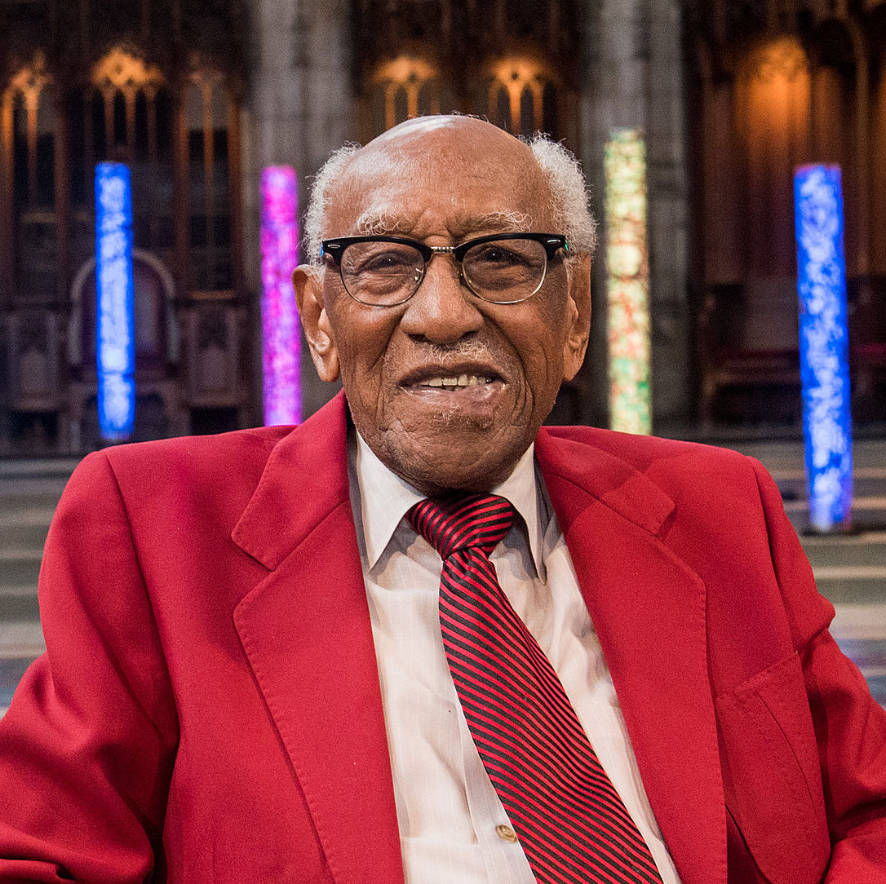
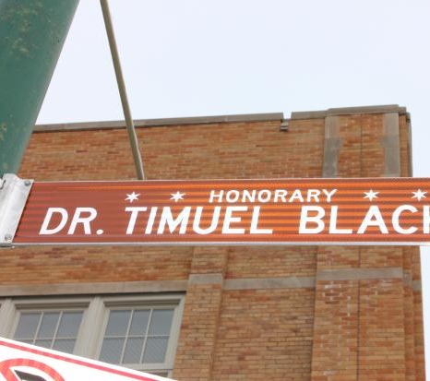
We can start with Prof. Timuel D. Black, whose life and work demonstrate just how culturally, historically, and philosophically significant Chicago’s South Side has always been!
We need to know where we are and who we are! And why we are here!
Pictured in the previous slides: Hazel Johnson, Carol Moseley Braun, Margaret Burroughs, Martin Luther King, Jr., Leon Despres, Bernard LaFayette, Jr., Jesse Jackson, Sr., Janette Wilson, Harold Washington, George Houser, Jim Robinson, John Lewis (Congressman), Bayard Rustin, Barack Obama, John Lewis (son of Julian Herman Lewis)

Slide 8

https://progressive.org/magazine/timuel-blacks-typical-life/
This wonderful personal memoir, published shortly after the author’s one hundredth birthday (December 7, 2018), tells of growing up in Chicago as part of “The Great Migration” of blacks to the North. Timuel Black’s parents arrived in Chicago in 1919 when he was about eight months old and settled in the African American community known as Bronzeville.
Black, who produced two volumes of oral histories of Bronzeville residents and is currently working on a third volume, sees this kind of storytelling as a key to our understanding of an important cultural history. He writes, “It seemed to me that both our physical history, the spaces and places of my Sacred Ground, and our spiritual history, our stories and memories, were being systematically destroyed.” He decided to tell his own story at the urging of friends, including fellow Chicagoan Studs Terkel.
Sacred Ground came about through a series of interviews conducted with Black over several years by public schools activist Susan Klonsky. Black had served in the 1990s as a community adviser for The Small Schools Workshop, co-founded by Klonsky and her husband, Michael. The interviews were edited by Bart Schultz, director of the Civic Knowledge Project at the University of Chicago’s Office of Civic Engagement, which, among other things, conducts tours of Chicago’s historic South Side led by Timuel Black.

Slide 9
So, here is lesson plan #1, courtesy of Norman Stockwell’s review of Sacred Ground
This wonderful personal memoir, published shortly after the author’s one hundredth birthday (December 7, 2018), tells of growing up in Chicago as part of “The Great Migration” of blacks to the North. Timuel Black’s parents arrived in Chicago in 1919 when he was about eight months old and settled in the African American community known as Bronzeville. Black, who produced two volumes of oral histories of Bronzeville residents and is currently working on a third volume, sees this kind of storytelling as a key to our understanding of an important cultural history. He writes, “It seemed to me that both our physical history, the spaces and places of my Sacred Ground, and our spiritual history, our stories and memories, were being systematically destroyed.” He decided to tell his own story at the urging of friends, including fellow Chicagoan Studs Terkel.

Slide 10
What is “oral history?”
For Black, oral history is important because it tells first-hand stories about everyday people’s lives. “To those who consider oral history ‘soft’ history, or somehow less valid, ” he writes, “I would say, it’s the people who are left out of history whose stories we are collecting and saving. “I’m telling stories that I hope capture a feeling, a spirit of what this place and its people have meant, ” he continues, “not just to me, but to our city and our country.” Black’s own story, his full century of participation in that place and with the people there, makes this book a powerful capturing of that spirit. “I believe my life is fairly representative of the lives of many of the children of migrants from the Deep South, ” Black states in the introduction. “My story’s typical-ness is precisely where its value lies.”

Slide 11
How typical is this life?
In the book’s title, and throughout its pages, Black refers to his South Side neighborhood as “Sacred Ground.” It is, he explains, “a real, hallowed space, from which major figures in the freedom movement emerged, and where historic commitments were forged.” Throughout the book, he shares the stories of those major figures, intertwined with his own life story and his personal development as a skilled and committed activist. Like many members of his generation, Black served in the army during World War II. The experience of racism and segregation in the military, as well as what he witnessed of the liberation of the Buchenwald Nazi concentration camp, was transformative. “This got me to reflecting, and I thought, this can happen anywhere to anyone, ” he says. “I determined that when I returned home I was going to spend the rest of my life working for peace and justice.” In his case, he continues, “political activism and organizing was the key to recovering from the whole deeply difficult experience of war. You never forget war, and you never get fully away from it.”

Slide 12
Is this typical?
Black worked with the Reverend Martin Luther King Jr. in the South in the early 1960s, and helped bring him to Chicago in 1966. In October 1963, he helped organize a boycott of the Chicago public schools by more than 200,000 people to protest the use of “mobile classrooms” (really trailers) at overcrowded black schools. In the early 1980s, Black worked to elect Harold Washington, another Bronzeville resident, as Chicago’s first African American mayor, presaging his later work for the adopted son of Chicago, Barack Obama. “[W]hile it thrived, the Washington campaign and its victory created the same kind of excitement at the local level that Barack Obama’s would generate on the national level two decades later, ” Black says. “It taught so many younger people about the power of an awakened, organized community.”

Slide 13
Or this?
Black sees Obama’s presidency as a watershed moment: “He was not all perfect, but he was historic.” As one of the lead organizers for getting people from Chicago to the March on Washington for Jobs and Freedom, Black remembers that event as “one of the greatest experiences of my life”—a feeling that still resonates today. He calls Obama “the beneficiary of the hopes and dreams of all kinds of Americans carried forward by those of my generation, struggling to achieve the impossible, but so often doubting that they can do it. His successor, I am sad to say, is contributing to the doubt, not to the dream.”

Slide 14
But what if you can do it too?
Black spent many of his working years as a teacher in the Chicago Public Schools, beginning in 1954, and later at City College, from which he retired in 1989. The philosophy he tried to convey to students was simple: “You are somebody, trouble don’t last forever.” In a letter sent to honor his ninetieth birthday, then-President Obama wrote, “We are all his students in a classroom that never closes.” Having grown up on Chicago’s South Side, within two miles of most of the various apartments in which Tim Black lived, I know the neighborhood, and many of the characters in this book from my own youth. I found the book to be both informative and inspirational, which was precisely Black’s goal. As he puts it, “There is still a lot to overcome. But we have overcome a lot, and we need to remember that. We can still do the impossible, maybe even the miraculous.” The kind of hope this book oers is rooted in perseverance and committed activism. Having seen so much over the past century, Black concludes, “even at my age, and in these times, times that seem so bad, I can keep on keepin’ on, and you can too.”
Review of Sacred Ground by Norman Stockwell, The Progressive, February 1, 2019

Slide 15
Okay, here are some questions to consider:
What was the “Great Migration”?
Why is “oral history” important?
What effect did World War II have on Prof. Black?
How did Prof. Black go about devoting himself to the fight for social justice? What did he do?
Who were some of the notable people influenced by Prof. Black?
What made Prof. Black such an effective educator?
Why does Prof. Black call his neighborhood on Chicago’s South Side “Sacred Ground”?
Keep these in mind as we watch a few short videos!

Slide 16
These are available for free on the Civic Knowledge Project website, https://civicknowledge.uchicago.edu/mlk-initiative.shtml
1. [Video] Timuel D. Black Jr.: 2020 Legendary Landmark. Landmarks Illinois honored Mr. Black at its 2020 Legendary Landmarks Celebration held March 5, 2020, in Chicago.
2. https://www.tiktok.com/@civicknowledgeproject?

Slide 17
Okay, time to think about all this, and what Prof. Black’s life might mean for you!
Please take 10-15 minutes to jot down your thoughts on what you have just learned about the life and work of Prof. Timuel D. Black. What do you think of his example? What would you like to ask him, if you got a chance to talk with him? Which of his “principles” or “life lessons” did you like best? Which least? Here they are again--

Slide 18
Ethical Principles and Life Lessons from Prof. Timuel D. Black
1.– All People are Equal. CKP Comment: The words of the Declaration of Independence have always needed to be made more inclusive and taken more seriously.
2. Together, people really can do the “impossible,” maybe even the “miraculous.” CKP Comment: Prof. Black learned this lesson during World War II. He remembers Eisenhower telling the troops “The impossible—we do that immediately; the miraculous may take a little longer.” He carried that message into his work for social justice.
3. You don’t quit because things aren’t were you want them to be at that moment, you keep pushing! CKP Comment: Hopes and dreams keep us alive. Prof. Black urges you talk to the elders—if your parents had not believed in the future, you would not be here.
4. Sometimes things get so singularly racial that people can’t see that it’s just human behavior. CKP Comment: Prof. Black is an activist and supporter of Black Lives Matter. He is also a democratic socialist who sees how important socio-economic class is. And he is a feminist who wants to see a woman become President of the U.S. He has always liked Dr. King’s message about how we are all part of a single garment of destiny, and how King acted on that message. In politics, and in life generally, it is important to judge people by their actions, not just their words. Prof. Black’s grandma would say to him, when he was making excuses for misbehaving, “I cain’t hear whatcha sayin’ cause whatcha doin’ talks so loud.”
5. A sense of community, of mutual support, is triumphant over immediate personal gain. CKP Comment: Prof. Black’s story, as he put it in Sacred Ground, is the story of his community, of Chicago’s historic Bronzeville. “You come from people”—that is something his Mama would always say to him. You need to talk to the ancestors, the elders, and help tell their story, since it is your story too. That is why he called his book “Sacred Ground.”
6. Music has a way of inspiring us and shows that there is no monopoly on joy. CKP Comment: Music, especially jazz music, has always been a source of inspiration and spirituality for Prof. Black. He loves these lyrics by the great Duke Ellington, “I don’t mind the gray skies/’cause they’re just clouds passing by.” And these lyrics by the famous South Side singer Sam Cook, “Well, you know, I’m so glad. I know that trouble don’t last always.”

Slide 19
Continued …
7. We can all be researchers, we can all be listeners, and we can all teach our children the skills of oral history. Talk to the elders! CKP Comment: Like his friend, the late Studs Terkel, Prof. Black has been a great champion of oral history. Oral history is often the “people’s history,” a way of recording the stories of the oppressed and dispossessed.
8. You don’t have to agree that somebody’s philosophy is correct to have an interesting and informative conversation with them. CKP Comment: Prof. Black may well be one of the most beloved activists and community organizers in the U.S., and one of the best teachers ever, and this is in part because, like Dr. King, he believes in people. He knows how to talk to people and how to listen to them, even if he seriously disagrees with them.
9. If you don’t know where you came from, it is difficult to know where you are and why you are. Know your heritage and share it. CKP Comment: Prof. Black’s memoir begins: “All four of my grandparents were slaves. I am the grandson and the greatgrandson of slaves on both sides … That is why I believe I am descended from the best and the brightest.”
10. You don’t have to be perfect to be historic. CKP Comment: Prof. Black had President Obama in mind when he wrote this principle. He supported and admired Obama, recognizing his historic importance, but he wanted to see more progress on matters of social justice.
11. Freedom is a constant struggle. CKP Comment: This is a famous line, and another song lyric, used in the “Song of the Freedom Singers” during the Mississippi Freedom Summer of 1964, and also used as the title of a book by activist Angela Davis.
12. Be prepared when the door of opportunity swings open, but above all, do not allow yourself to be bought. CKP Comment: Prof. Black is very proud that over the course of his long life he has never allowed himself to be bought--that is, has never sold out to the forces of power and domination. He has always remained authentic and true to himself.

Slide 20

Can you think of some principles that you would like to add?

Slide 21
Here is a poem to help you think, from Prof. Black’s close friend Dr. Margaret Burroughs, artist, educator, and founder of the DuSable Museum of African American History--
What will your legacy be? Legacy? Legacy? Do you know what the word “Legacy” means? Well, if you don’t know, let me tell you what the dictionary says it means. Legacy: property or money left to someone by a will; something handed down from those who have gone before; a legacy of honor, our legacy, of freedom. In this poem, I’m not referring to material things like property or money, either of honor or of freedom. I am referring to what a person has done with this life that God has given to him or her. Yes, I want to know what will your legacy be? This is a question that I would like to put to each and every one of you? What will your legacy be? When you have finally cast off these mortal coils? When you have crossed the great divide? What will your legacy be? When you can no longer run life’s race. When you no longer have a place; when you have at last completed the circle round and when an escape is no longer to be found. What will your legacy be? When you walk into the unknown all by yourself and alone, What will your legacy be? Stop for a moment and listen to me and answer this question if you can. What will your legacy be? When you must cross that great divide into an area from which none can hide. When you, alone, with no one by your side with no friend to lead you or to hold your hand? What will your legacy be? What deeds have you done in your lifetime which will be left for you to be remembered by? Will it be just a gray decaying tombstone standing alone in a cemetery or will it be, as it should be some act, some service or some deed that will insure that you will be remembered on and into the eternity of life’s game? I ask you. What will your legacy be? Will it be the fact that you helped somebody along the way, during the time while you were here on earth? What will your legacy be? Will it be similar to the legacies left to our generation by people like Harriet Tubman, Sojourner Truth, Frederick Douglass, John Brown, Ida B. Wells, Mary Bethune and so many others who made of their lives a bridge for us to cross over on and whose lives were an inspiration for us of today to make of our lives bridges for future generations to cross over on? What will your legacy be? Legacy! Legacy!

