Slide 1

David Schwieder, Ph.D.
dschwieder@uflib.ufl.edu

Slide 2
Expert Scholarly Information Search
Finding the Sources You Need
in the Library and on the Web

Slide 3

VPN
Program
The
LIBRARY
IMPORTANT NOTE: Many types of library materials are now online in electronic form. This includes e-books, theses and dissertations, and virtually all journal articles. You can access these directly when you are on campus, but to access these materials from off-campus, you will have to log into the UF computer network. To do so, go to the Library home page, www.uflib.ufl.edu and put your cursor over “Using the Libraries,” then click “Off-Campus access.”
On the right, you will see a download link for the UF Virtual Private Network (VPN), a program that will allow you to connect with the UF network. You will have to download a small piece of program software, and install it on your computer (much like doing this with Adobe Acrobat Reader or Flash on a PC).
Instructions for downloading and installing the VPN are at:
https://guides.uflib.ufl.edu/VPN_Instructions

Slide 4
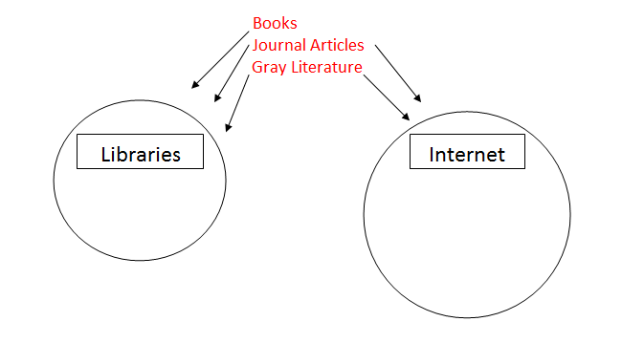
Basic Elements I. “What to Look For and Where to Look For It” – Scholarly Sources and Resources
Gray Literature consists of formally unpublished material: dissertations, reports, etc.

Slide 5
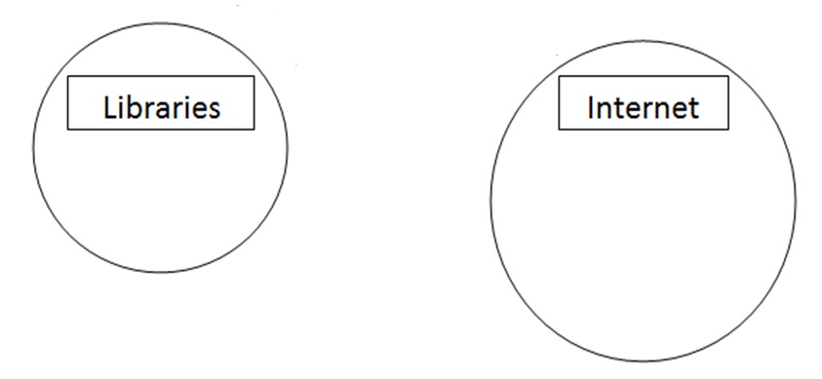
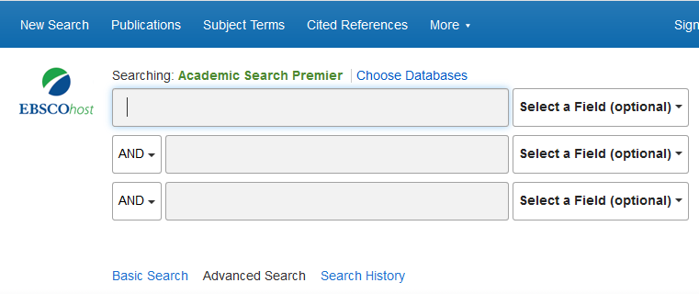
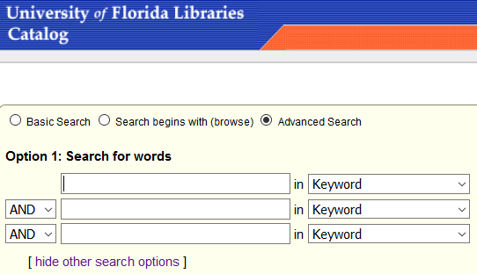
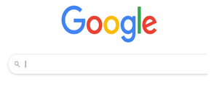
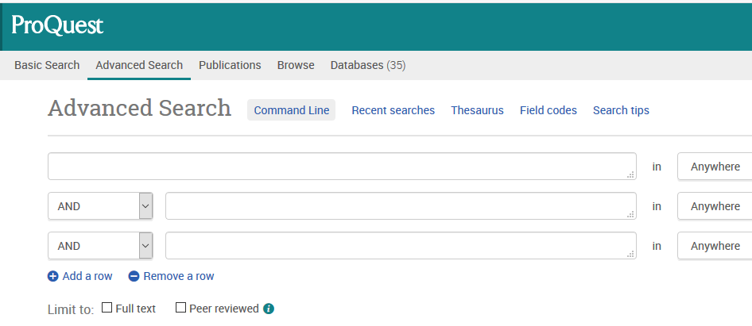
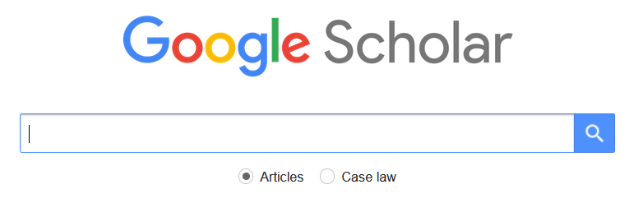
Basic Elements II. Library and Internet Search Engines
Library Catalog
Databases
Google
Google Scholar
Specialized
Search Tools

Slide 6
Basic Elements III. Two-Part Information Search Strategy
1) Good Search Terms
2) Effective Search Limiters

Slide 7

A Motivational Moment…
A Small amount of effort
devoted to learning
information search…
…Will pay off really Big

Slide 8
1) Good Search Terms
2) Effective Search Limiters
Example: Basic Google

Slide 9
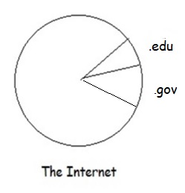
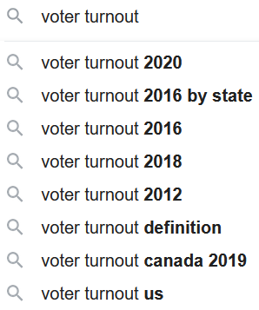
Example: Using the Search Strategy in Basic Google
Good Search Terms Effective Search Limiters

Slide 10
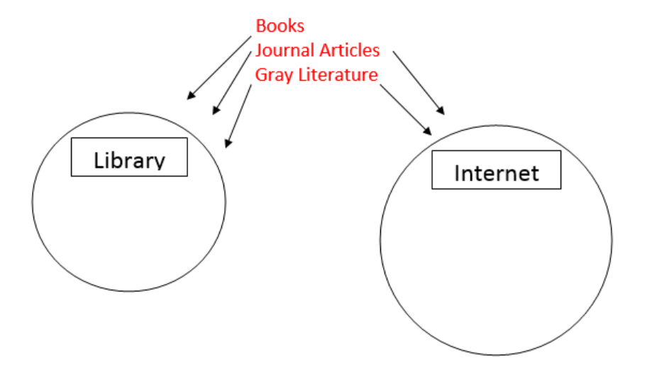
I. Searching for Books
Library Catalog
www.uflib.ufl.edu Put your cursor over “Find” then click “Books” then click “Library Catalog” Click the
small circle that says “Advanced Search”

Slide 11
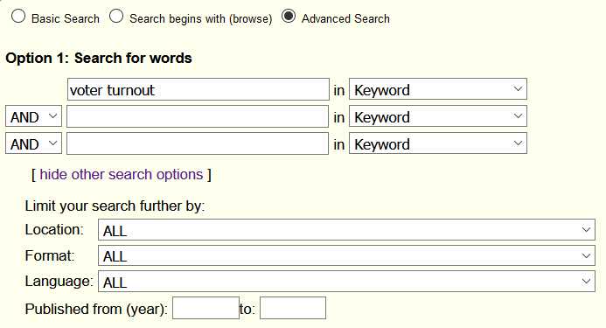
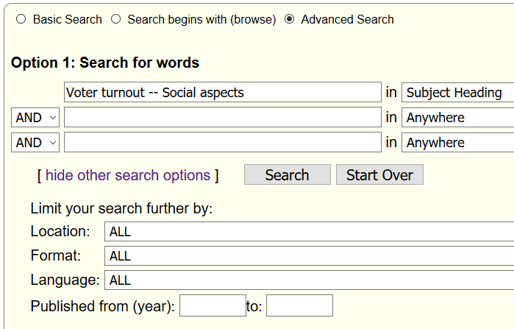
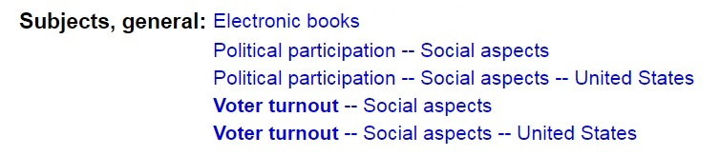
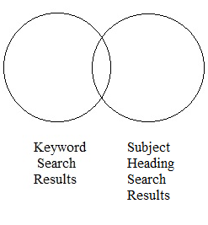
Strategy: Good Search Terms for Books
Keywords vs Subject Headings
Do an initial search (using your own keywords—that is, search terms you come up with yourself), then click on the title of a book that
matches your interests. Then scroll down until you see Subjects, general: These are the Subject Headings. If you find a relevant
Subject Heading, type it into the search slot, and make sure to select “Subject Heading” with the drop-down menu to the right of the
search slot. Subject heading search will give you different—and often better—results than keyword search.
Keyword and Subject Heading searches produce different (but partially-overlapping) sets of results. Doing both kinds of searches will usually increase the number of good results that you get.

Slide 12
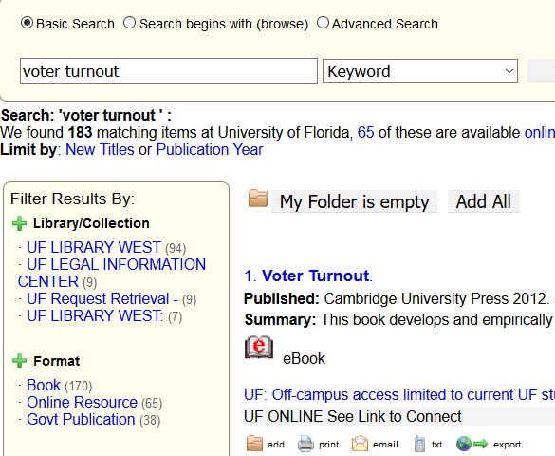
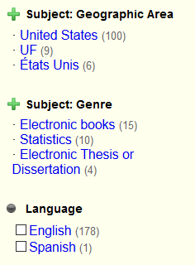
Strategy: Search Limiters for Books
In the catalog, the limiters are found to the left of your search results. Publication year can be used to produce more recent results.

Slide 13

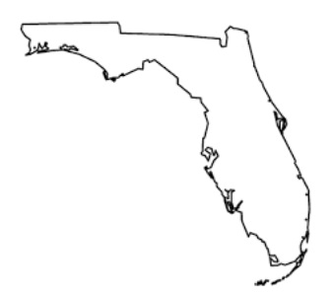

Searching for & Getting Books
UBORROW
WorldCat (or Other)
Interlibrary Loan

Slide 14
Searching for Books Beyond UF
UF Library Catalog
1) UBORROW (All State University Libraries in Florida)
…then after you do a search, click the blue link at the top right, Show XXX items
2) WorldCat (Worldwide Library Catalog) Put your cursor over Find” then click “Databases”
then click “A-Z Databases” then click “W” and scroll
down to WorldCat,

Slide 15
II. Searching for Journal Articles
UF Libraries Databases www.uflib.ufl.edu
General (Academic Search Premier, ProQuest) Put your cursor over “Find” then click “Databases” then click “Project Starter
Databases” then scroll down.
Discipline-Specific Put your cursor over “Find” then click “Databases then click “A-Z Databases” then use the search box at the top to search for databases relevant to your discipline.
UF Libraries Journal Search Tool Put your cursor over “Find” then click “Journals” then click
“Find Journals” then use the search box at the top to search for journals relevant to your topic or discipline.
Google Scholar www.google.com/scholar (Note: If you are off campus, log into the Library with the VPN before
searching with Scholar. You will get many more articles)
“Pirate” Sites

Slide 16
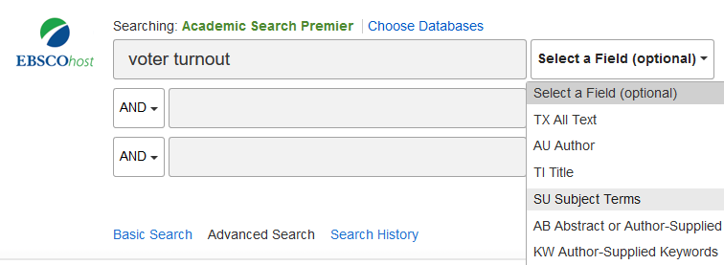
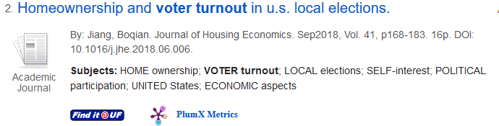
Strategy: Good Search Terms For Journal Articles
Keywords vs Subject Headings
In journal article databases, the Subject Headings are usually included in the search results, as you see above.
(Labelled here as Subjects:) If you find a Subject Heading you like, type it into the search slot, and make sure to select “Subject Terms” (or another appropriate term, depending on the database) using the drop down menu to the right of the search slot, as above.

Slide 17
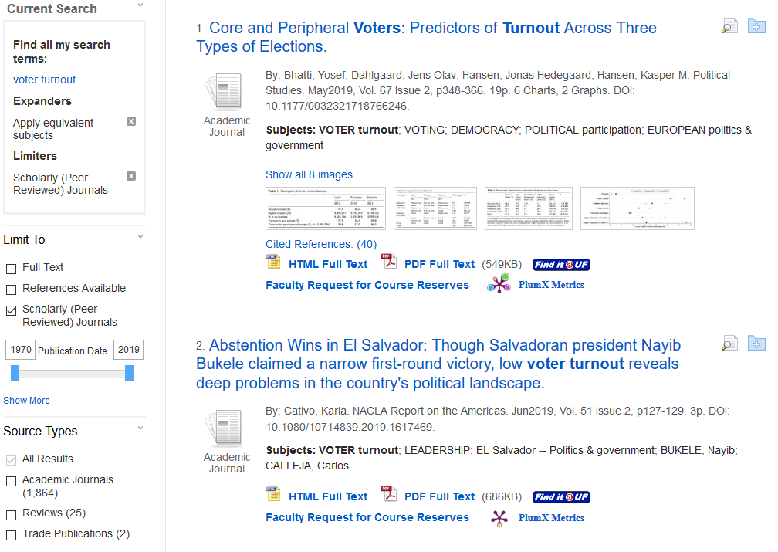
Strategy: Search Limiters for Journal Articles
With most journal article databases, the limiters are located to the left of the search results (or, in some cases, at the bottom of the screen).

Slide 18
Searching for & Getting Journal Articles
UF Libraries Databases Other Tools
Google Scholar
Pirate Sites
Interlibrary Loan Interlibrary Loan

Slide 19
Searching for Specialized Library Sources: Literature Reviews
UF Libraries
Annual Reviews
Do a search for Annual Reviews in the Library Catalog
Subject Handbooks
Search your subject term + handbook in the Library Catalog
Literature Review Journal Articles
Just add “literature review” or “review of the literature” to your own subject terms in Google Scholar or a Library Journal Search Engine

Slide 20
Searching for Gray “Unpublished” Literature
Major Types of Gray Literature
Dissertations and Theses
Conference Papers
Government Documents and Publications
Materials from Scholarly and Private Organizations
University Materials

Slide 21
Theses and Dissertations
UF Libraries Internet
T&D done at UF: ProQuest Theses & Dissertations Other T&D
Databases
Put your cursor over “Find” then click “Databases”
then click “A-Z Databases” then click “P” and scroll
down to “ProQuest.” Click the “Theses and Dissertations
tab. Click the blue link below the search slot You are
searching [Number} databases and scroll down.
UF Institutional Repository
https://ufdc.ufl.edu/ufirg
Worldwide: ProQuest Theses & Dissertations Other T&D Databases
Database
Put your cursor over “Find” then click “Databases”
then click “A-Z Databases” then click “P” and scroll
down to “ProQuest.” Click the “Theses and Dissertations
tab.

Slide 22
Conference Papers
Internet
Cross-Disciplinary Repositories (e.g. SSRN)
Disciplinary Repositories
Professional Association Sites
“Dataverses”

Slide 23
Government Documents and Publications
Internet
Government Websites
U.S.
gpo.gov
Branch/Agency Sites e.g. USDA, EPA, etc.
Basic Google with .gov Site Limiter

Slide 24
Gray Literature Materials from Colleges and Universities
Internet.
Basic Google with .edu Site Limiter
and filetype limiter for pdf files e.g. voter turnout site:.edu filetype:pdf
Include “Centers or Institutes” in Search Terms
e.g. voter turnout center site:.edu e.g. voter turnout institute site:.edu

Slide 25
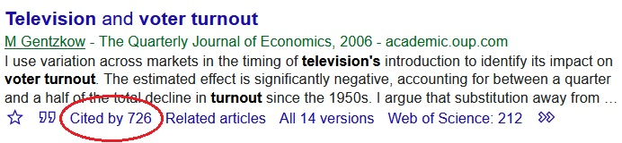
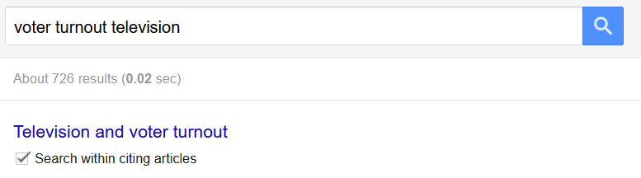
Specialized Strategies
Include “libguide” in Basic Google Search Terms
e.g. voter turnout libguide OR climate change libguide
“Chasing Citations” Backwards & Forward
Check Bibliography for Backwards (Previous) Citations
Use Google Scholar “Cited by” link for Forward (More recent)
Citations
Specialized Strategies and Tactics
      “Citation Chasing” Backwards & Forwards
Note: After you click the “Cited by” link, click the box for “Search within citing articles” and retype your search term in the search slot

Slide 26
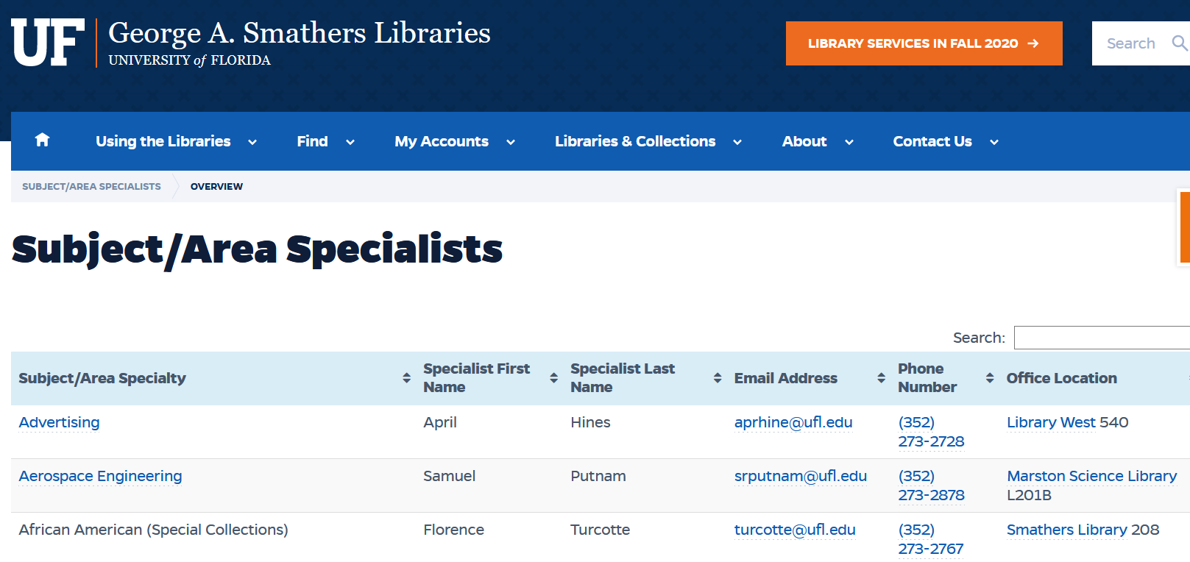
And Finally…
Help from UF Subject Specialist Librarians:
https://uflib.ufl.edu/specialists/

