Slide 1
Metrash2
HOW TO RENEW QATARI IDs FOR FAMILY-SPONSORED DEPENDENTS
December 2019

Slide 2
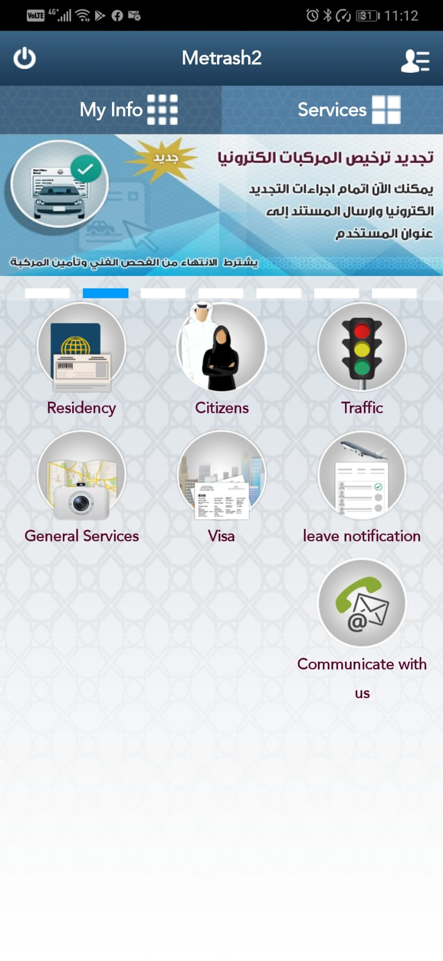

1. Select RESIDENCY.

Slide 3
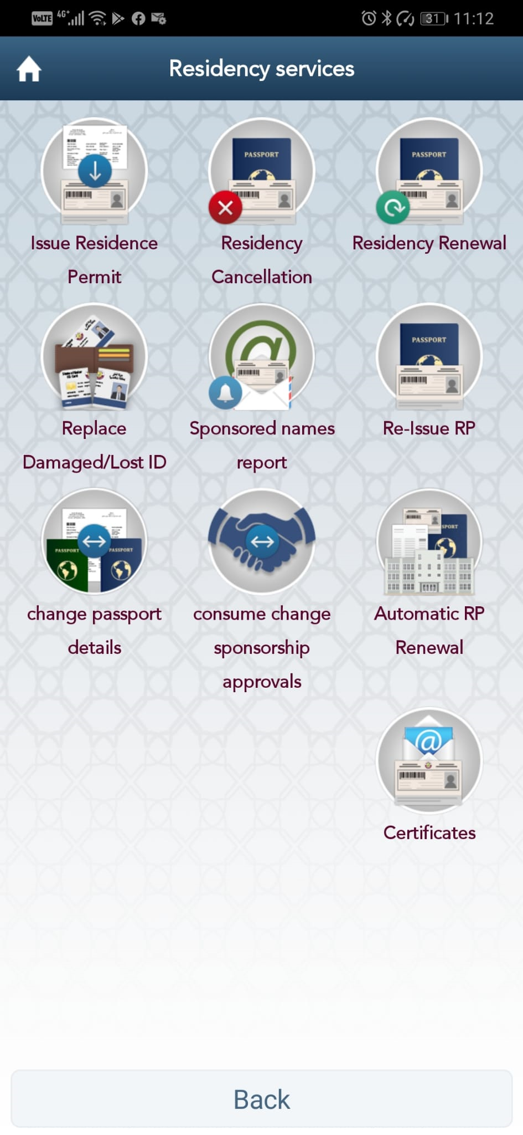
2. Select RESIDENCY RENEWAL.

Slide 4
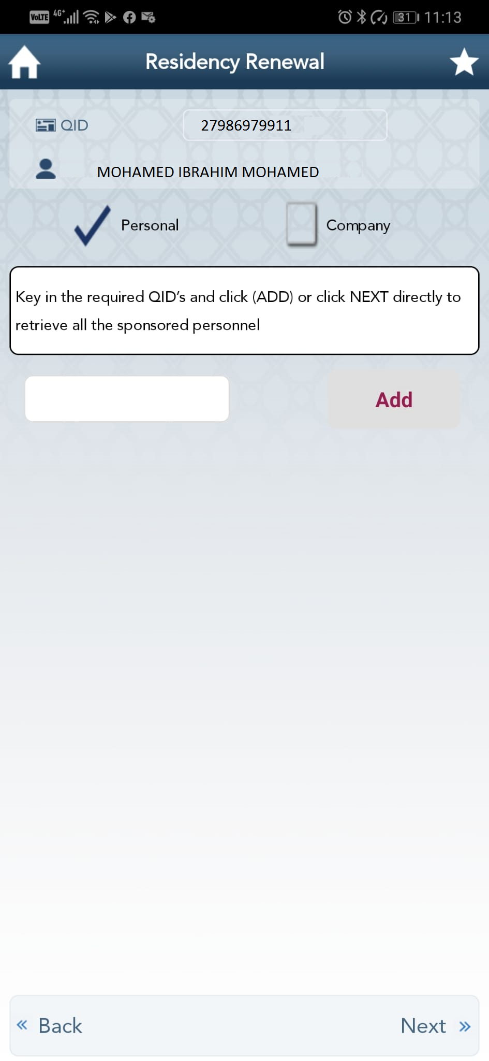
3. Select PERSONAL tick box and then press NEXT.

Slide 5
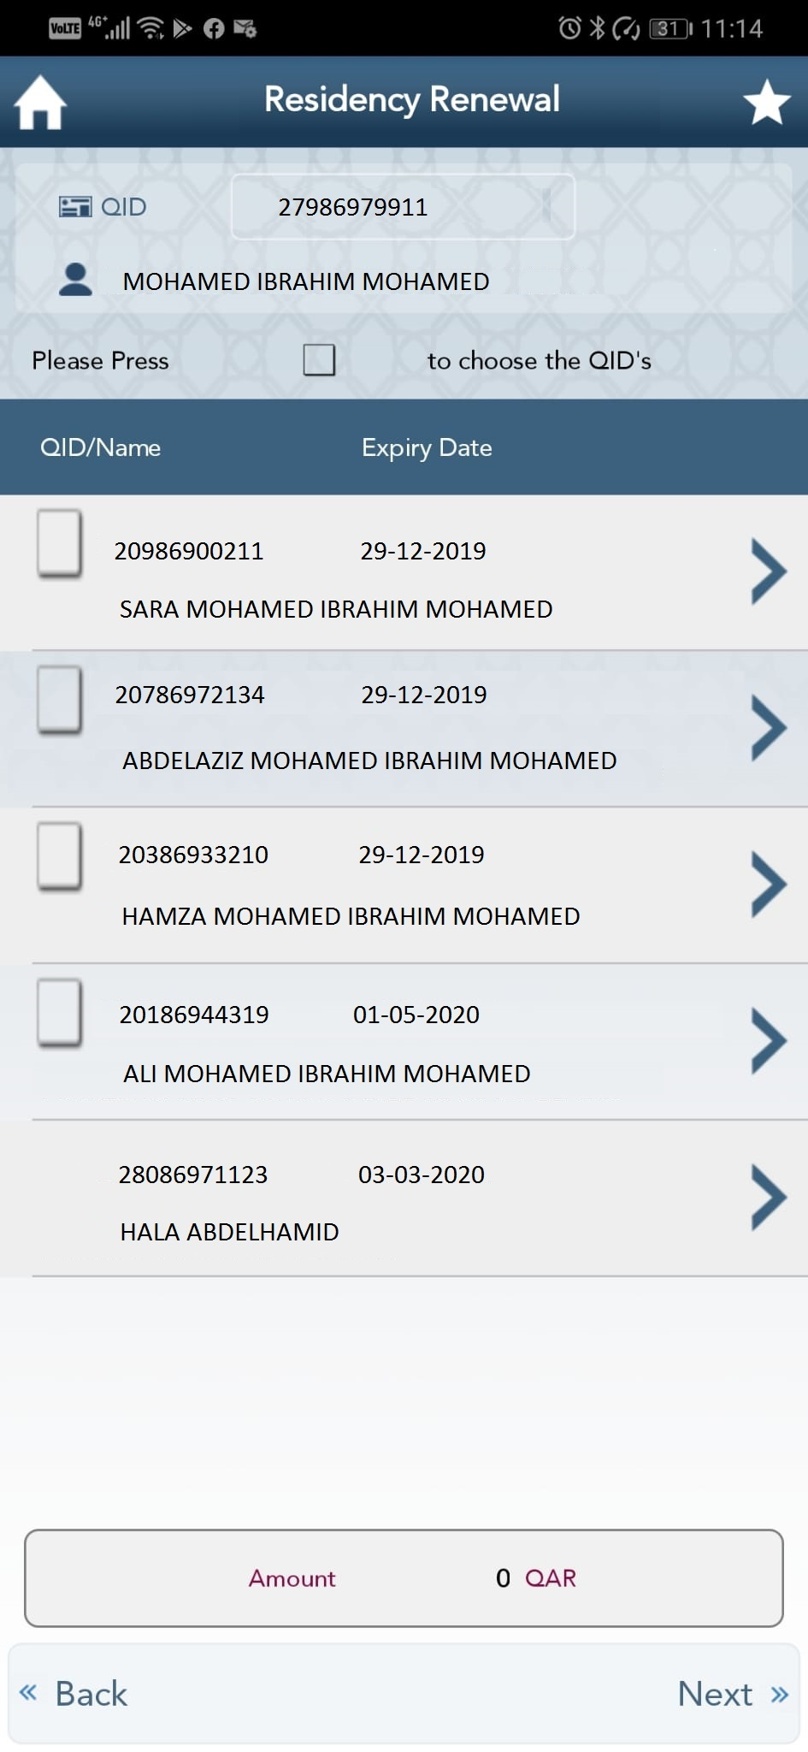
4. When List of Sponsored Dependents appear, select the dependent name/s’ tick box/tick boxes for residency renewal, and press NEXT.

Slide 6
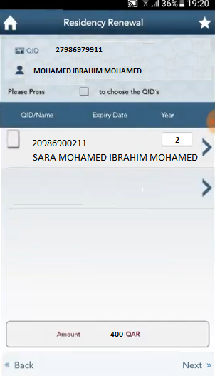
5. You are now redirected to a page where you will be required to select the number of years of renewal:
QF-sponsored staff renewal fees for dependents are*:
1 year – QAR 250
2 years – QAR 400
3 years – QAR 550
Then, press NEXT.
*If you are being charged or are exceeding the above fees, PLEASE DO NOT PROCEED AND CONTACT YOUR HR FOCAL POINT FOR ASSISTANCE.
*If you have a sponsored teen dependent who is turning 18 years, please select the 1-year validity option only.

Slide 7
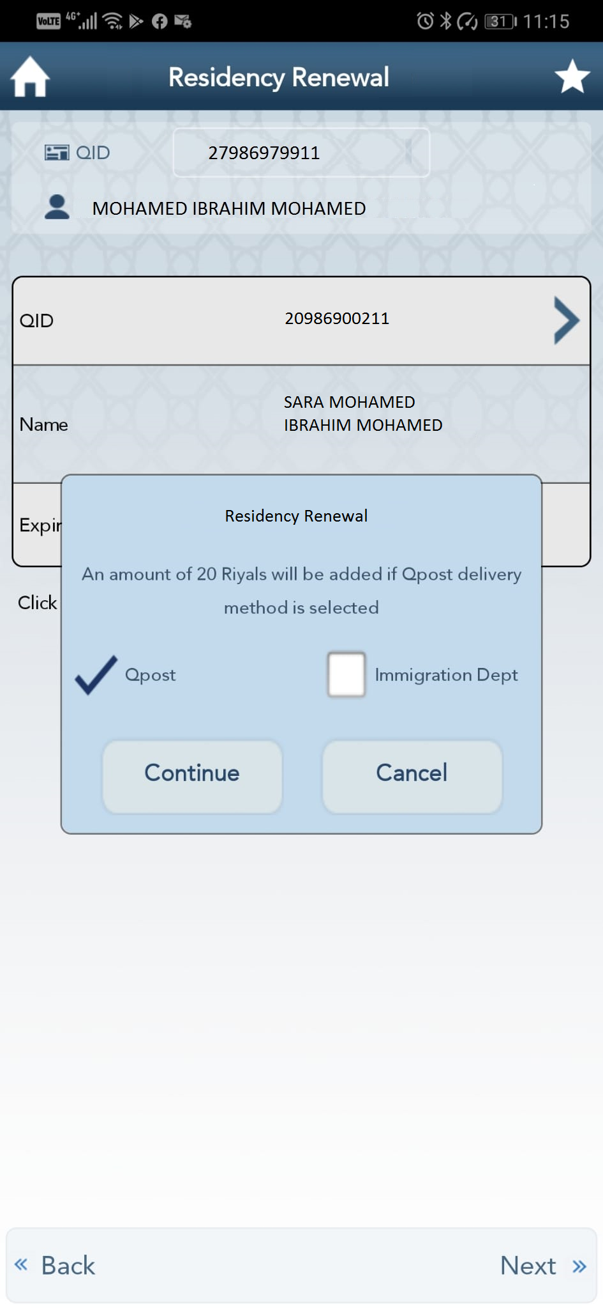
6. Select mode of delivery:
Q-POST (with additional QAR 20 fee for delivery); or
IMMIGRATION DEPT (for personal pick up from any MOI Immigration Service Center https://portal.moi.gov.qa/wps/portal/MOIInternet/aboutministry/ourlocations ).
Choose Q-POST if you prefer home delivery, then press NEXT.
Choose IMMIGRATION DEPT if renewed Qatari ID is required urgently, the Qatari ID photo needs to be changed or updated or you have a designated center Immigration Focal Point who can collect the renewed QID/s for you. Press NEXT, and proceed directly to slide 10 –Payment.

Slide 8
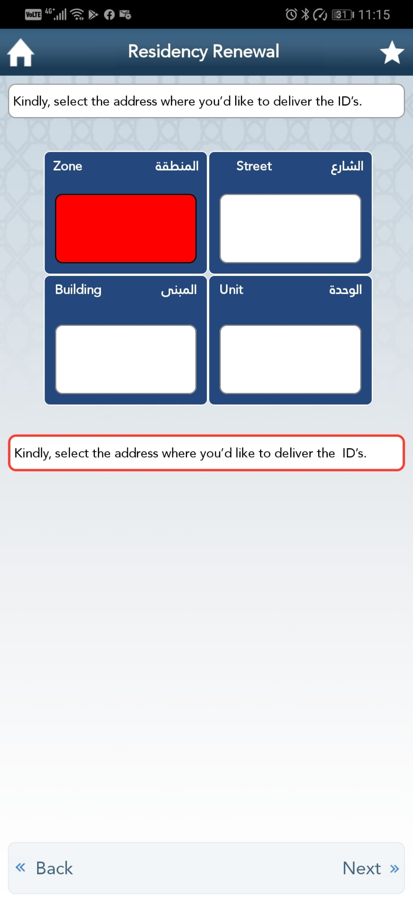
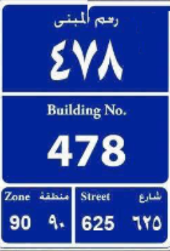
7. Enter ZONE NUMBER, STREET NUMBER and BUILDING NUMBER as per Baladiya address signage plate generally found outside your Building or accommodation
(below is for sample/reference only).
Press NEXT.

Slide 9
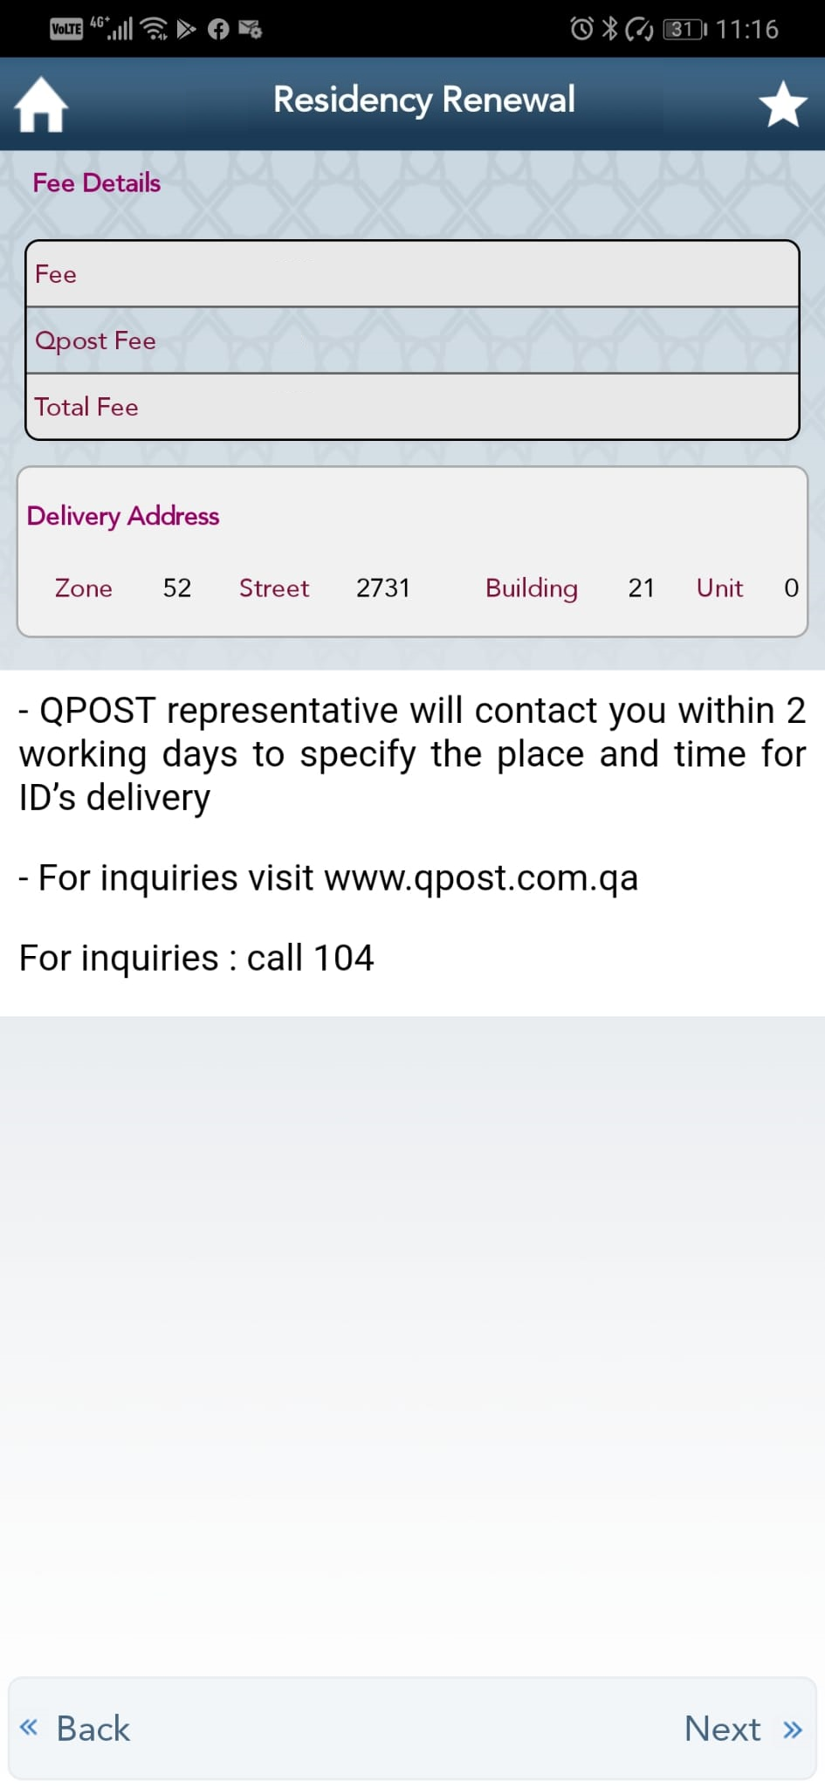
8. You are redirected next to the Fees’ Summary page and delivery address.
Press NEXT.

Slide 10
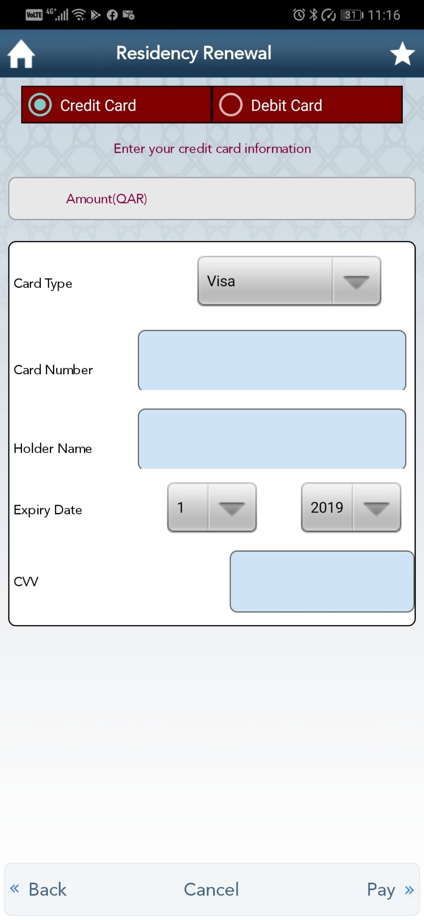
9. Select payment option –
CREDIT CARD; or
DEBIT CARD.
Complete CREDIT CARD or DEBIT CARD INFORMATION fields, and press PAY.
You will be redirected next to the transaction confirmation page.
Then, press DONE.

Slide 11
Applying for ERP Immigration Expense Reimbursement
Please save the receipt you will receive at the end of the residency renewal transaction so you can apply for ERP Immigration Expense reimbursement after renewed dependent QID/s are received, keeping in mind reimbursement eligibility is subject to ERP-approved beneficiaries only.
Requirements to be attached when raising ERP immigration expense reimbursement are:
Copy of renewed dependent Qatari ID/s (front and back)
Copy of receipt/s
Copy of the sponsor/employees’ Qatari ID (front and back)
Expense type to be selected is: QID Renewal for Dependents.
For multiple dependent QID renewals for 2 or more dependents, please raise individual, separate expense reimbursement requests for each dependent.
ERP expense claim must be raised within 30 days from transaction or receipt date.

Slide 12
Thank you.

