Slide 1

Academic Integrity “Quiz”
These materials were designed for you to adopt and adapt. In the spirit of academic integrity, we would appreciate that you acknowledge the original contributors in some way (e.g., this exercise has been adapted from XXXX).
Author: Dr. Laurie McNeill
Activity: Academic Integrity “Quiz”
Dr. Laurie McNeill
University of British Columbia
© Laurie McNeill. Open Access This handout is distributed under the terms of the Creative Commons Attribution 4.0 International License (http://creativecommons.org/licenses/by/4.0/), which permits unrestricted use, distribution, and reproduction in any medium, provided you give appropriate credit to the original author(s) and the source, provide a link to the Creative Commons license, and indicate if changes were made.

Slide 2
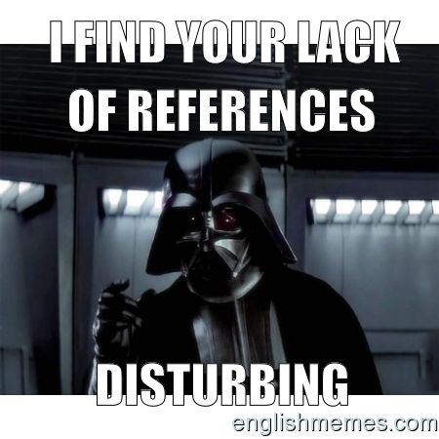
Confirming our understanding of academic integrity
© Laurie McNeill. Open Access This handout is distributed under the terms of the Creative Commons Attribution 4.0 International License (http://creativecommons.org/licenses/by/4.0/), which permits unrestricted use, distribution, and reproduction in any medium, provided you give appropriate credit to the original author(s) and the source, provide a link to the Creative Commons license, and indicate if changes were made.
Notes:
You’re going to vote yes or no: yes = green, no = purple.

Slide 3

http://www.charlottearthurmurray.com/wp-content/uploads/2013/03/misconceptions.jpg
Should you cite in these cases?
I looked at different websites (or articles, books, etc.) just to get ideas
I refer to information that would be known to my readers (aka “common knowledge”), e.g., “WWII started in 1939.”
I used ideas from a source, but I put them in my own words.
© Laurie McNeill. Open Access This handout is distributed under the terms of the Creative Commons Attribution 4.0 International License (http://creativecommons.org/licenses/by/4.0/), which permits unrestricted use, distribution, and reproduction in any medium, provided you give appropriate credit to the original author(s) and the source, provide a link to the Creative Commons license, and indicate if changes were made.
Notes:
Example: I read Sparknotes summaries of Girl, Interrupted for ideas and then I wrote my own summary.

Slide 4
Reminder: Acceptable paraphrase
Has reporting expression (or name in citation) AND page number
Is 100% in your own words and sentence structure
Accurately represents the original
See Ethical Research Handout* |Canvas
  * Ethical Research Handout on https://blogs.ubc.ca/academicintegrity/pedagogies-of-integrity/
© Laurie McNeill. Open Access This handout is distributed under the terms of the Creative Commons Attribution 4.0 International License (http://creativecommons.org/licenses/by/4.0/), which permits unrestricted use, distribution, and reproduction in any medium, provided you give appropriate credit to the original author(s) and the source, provide a link to the Creative Commons license, and indicate if changes were made.

Slide 5
Acceptable or Unacceptable Paraphrase?
Original:
What saved Sienkiewicz-Mercer from languishing in the institution was her ability, using very limited means, to connect with those around her.
The only thing that prevented her from languishing in an institution was her ability to connect with people around her by using nothing but eye movements (Couser 42).
© Laurie McNeill. Open Access This handout is distributed under the terms of the Creative Commons Attribution 4.0 International License (http://creativecommons.org/licenses/by/4.0/), which permits unrestricted use, distribution, and reproduction in any medium, provided you give appropriate credit to the original author(s) and the source, provide a link to the Creative Commons license, and indicate if changes were made.

Slide 6
Acceptable or Unacceptable Paraphrase?
Original: [Autobiography] can personalize and humanize categories of people whose experiences are frequently unseen and unheard….make powerful interventions in debates about social justice, sovereignty, and human rights. [Whitlock 3]
Life narratives have the power to promote public awareness regarding important global issues that may go unnoticed by the international community (Whitlock 3).
© Laurie McNeill. Open Access This handout is distributed under the terms of the Creative Commons Attribution 4.0 International License (http://creativecommons.org/licenses/by/4.0/), which permits unrestricted use, distribution, and reproduction in any medium, provided you give appropriate credit to the original author(s) and the source, provide a link to the Creative Commons license, and indicate if changes were made.

Slide 7
Are these cases of academic misconduct?
I listed all the sources I used in my paper at the end, in my Works Cited, but I didn’t always use in-text citations.
My mom read my paper and fixed my grammar.
My mom read my paper and gave me some feedback.
I included a sentence from a source but used a thesaurus to change the words. I did include a page number and reporting expression.
My prof said not to use Wikipedia, so I didn’t cite it (though I used it anyway).
I cited a source I read about in another article but didn’t read.
© Laurie McNeill. Open Access This handout is distributed under the terms of the Creative Commons Attribution 4.0 International License (http://creativecommons.org/licenses/by/4.0/), which permits unrestricted use, distribution, and reproduction in any medium, provided you give appropriate credit to the original author(s) and the source, provide a link to the Creative Commons license, and indicate if changes were made.
Notes:
OK = green, not OK = purple

Slide 8
Problems & solutions
I guess I didn’t put quotation marks around that phrase in my notes, so I didn’t know I was using the words from the original.
I had so many tabs open on my desktop that I was sure who said what.
I didn’t know how to cite [various sources]
I had 3 papers due in 24 hours and I was really stressed out.
© Laurie McNeill. Open Access This handout is distributed under the terms of the Creative Commons Attribution 4.0 International License (http://creativecommons.org/licenses/by/4.0/), which permits unrestricted use, distribution, and reproduction in any medium, provided you give appropriate credit to the original author(s) and the source, provide a link to the Creative Commons license, and indicate if changes were made.

Slide 9
Review our collaboratively-produced definition of academic integrity*:
Would you add, delete, reword any part of it?
What parts strike you now as most significant?
*See Defining Academic Integrity Exercise: https://blogs.ubc.ca/academicintegrity/pedagogies-of-integrity/
© Laurie McNeill. Open Access This handout is distributed under the terms of the Creative Commons Attribution 4.0 International License (http://creativecommons.org/licenses/by/4.0/), which permits unrestricted use, distribution, and reproduction in any medium, provided you give appropriate credit to the original author(s) and the source, provide a link to the Creative Commons license, and indicate if changes were made.

